Slide 1


PRIVATE SECURITY IN BRAZIL:
STRUCTURE, SCOPE AND
UNION ORGANIZATION
Jerfferson Simões
Fenavist Director
President of WSF

Slide 2
Who we are?
The National Federation of Security and Cash in Transit Industry (Fenavist) is a employers union entity founded in March 1989. Therefore, it has been operating for 30 years to represent the interests of the Brazilian private security segment;
Headquartered in Brazilia, capital of Brazil, the Federation aggregates unions in the 27 federative units of the country, and associations representing about 2,694 industries, responsible for the generation of more than 553,905 direct jobs. Fenavist has national jurisdiction and is also affiliated with the National Confederation of Trade in Goods, Services and Tourism – CNC;
In partnership with the unions, Fenavist is committed to represent the private security sector in a broad and transparent way, with the aim of valuing industries and their vigilants, providing services and promoting modernization and growth for Activity.

Slide 3
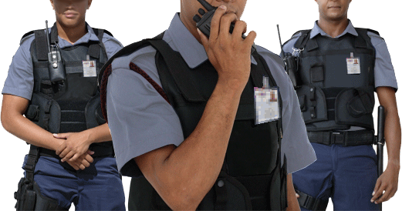
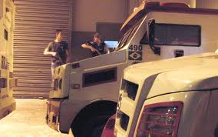
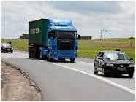
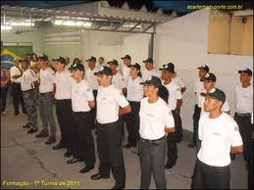

REPRESENTATIVENESS
These are activities represented nationally by Fenavist:
Asset surveillance;
Cash in Transit;
Armed escort;
Personal security;
Training courses for Vigilantes
(Electronic safety for soon Regulation)

Slide 4
Importance of Segment
Private security is complementary to public security, but does not compete or replace public action;
Expertise in industries, direct public administration, public companies and companies of mixed economy, private companies, banks, schools, hospitals, residences and others (Intramuros).
The whole population, regardless of whether they pay directly for it or not, is benefited!

Slide 5

Legislation
All activities related to private security are controlled by the Federal Police;
The main guidelines of the activity were established by the Law 7.102/1983, which establishes rules for the operation, supervision, preparation of the vigilant among others. Over the years, the legislation has undergone some changes by means of other laws (8.863/1994; 9.017/1995), Disorders and ordinances.

Slide 6
Legislation
All surveillance/security services, whether provided in the industry, banks, public agencies, commerce, residences, condominiums, events, etc., must be carried out by a industry regularized and technically able to work in the activity. A private security industry, to carry out its activity, needs to have technical competence and legal qualification.
All vigilants must meet requirements: initially 200hour/class of training of Vigilants, with:
  Biannual refresher Course (update) of the vigilants issued by the training schools and registered in the Federal Police.
  Presentation of the criminal record certificates of the vigilants who will work with the service stations.
  Physical health examinations of vigilants, as well as the annual psychological examination.
  Certificates of presentation and recommendation of services.

Slide 7


Sector Numbers
2.694
INDUSTRIES
553.905
WORKERS
According to the survey, in 2018, there were 2,694 industries authorised to act in private security. The Southeast region concentrates most of them, 1,062 companies (39.4%). Then, the Northeast (593/22.0%), the South (527/19.6%), the Midwest (304/11.3%) appear and the North (208/7.7%).
Of all authorized industries, 296 are training courses. The number remained stable in relation to 2014, when there were 297 schools able to give the training course for vigilants.
Currently, there are 553,905 jobs. Also in the number of workers the Southeast region leads. They are 272,224 (49.1%). In the Northeast are 111,893 (20.2%). The South has 84,538 workers (15.3%). Then the Midwest appears 53,841 (9.7%) and North 31,409 (5.7%).
Of the total number of workers, 476,000 are vigilant. The rest of the employees operate in other functions of the companies.
Between 2014 and 2018, around 100,000 jobs were closed.
SOURCE: VI ESSEG

Slide 8

Sector Numbers
Revenues R$ 33,767 billion
Last year, security, surveillance, armed escort, cash in transit and training courses received for the services provided, according to estimates, R$ 33,767 billion. Nearly one billion less than in 2017, which had already registered drop compared to 2016.
It is important to emphasize that the values do not correspond to the profit. They also include expenses with salaries, taxes, social charges and other.
SOURCE: VI ESSEG

Slide 9


Sector Numbers
STRONG-CARS
4.726
AVERAGE SALARY R$ 2.139
In the private security segment there are 4,726 strong cars. Still in the cash in transit are used 826 light cars. In the armed escort are used 3,620 cars. There are still other 6,125 vehicles employed in the segment.
In all cases there was an increase of 2017 to 2018.
In 2018, the average readjustment of the salaries of the vigilants was 2.43%. The value is below inflation (3.39%). However, since 2014 workers had a real gain of 7.32%.
The average salary is R $2,139.8. The value is 25.7% higher than the amount paid in 2014. In addition, 55% of workers receive between 2 and 3 minimum wages.
SOURCE: VI ESSEG

Slide 10
Future (Statute of Private Security)
Fenavist has developed, in recent years, a work of awareness of Brazilian parliamentarians, in order to approve the new Statute of Private Security. Already approved in the Federal Chamber and in the final phase of approval in the Federal Senate, the Law Project will modernize and update the current legislation, in force for 36 years, and therefore totally laged with regard to the needs of the country.
The new law will establish a completely new legal regime, aiming to give more legal certainty to the industries constituted in the legal criteria and therefore will curb and criminalize more rigorously the clandestinity.
In addition, new services will be included in private security and subject to Federal Police oversight, for example:
– Event security: Unarmed or using only weapons of lesser offensive potential, prohibited the use of firearm;
– Security in collective land, water and marine transport: unarmed or using only weapons of lesser offensive potential, or, provided that there is express authorization from the Federal Police, with the use of a firearm;

Slide 11
Future (Statute of Private Security)
– Perimeter security in the walls and Sentry boxes of prisons: unarmed, armed with a firearm or of lesser offensive potential;
– Safety in conservation units: unarmed, armed with a firearm or less offensive potential;
– Monitoring of electronic security systems and tracking of cash, goods and values: unarmed or using only weapons of lesser offensive potential, prohibited the use of firearm;
– Risk management in cash transit operations, goods or values: only unarmed, prohibited the use of firearm or less offensive potential;
– Access control in ports and airports: unarmed, armed with firearm or less offensive potential;
– Express prediction allowing the securities transit industry to be able to provide the storage, custody and processing services of the cash and the values of its customers;
– Other services that fall within the precepts of the new law, in the form of the regulation: unarmed, armed with a firearm or of lesser offensive potential, provided that there is express authorization from the Federal police.

Slide 12



Union Organization
CNC
FENAVIST
UNIONS

Slide 13
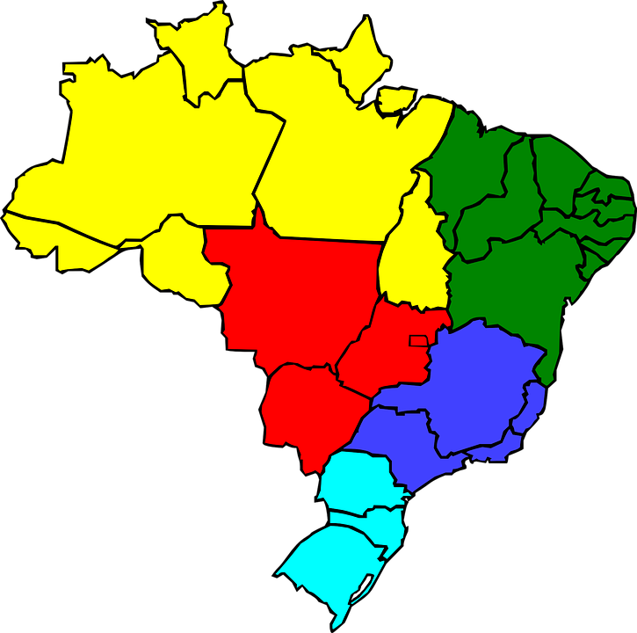
Union Organization
In Brazil, both industries and workers have unions in all States.
The entities negotiate collective labour conventions.
When necessary, they work in partnership to defend the interests of the segment. One example is the Statute of Private Security.

Slide 14
Union Organization
If we consider the entities representing all categories, there are more than 16000 unions throughout Brazil. The figures include employers and workers.
Unionism in Brazil gained momentum in the years 1930. The Getúlio Vargas government created the Ministry of Labor and submitted the entities to the entity.
During the military dictatorship, the unions were again suffering resistance, as they were considered centers of resistance.
With the Redemocratization, in the mid-1980 years, Unionism has gained momentum again. Between 2003 and 2016, the period in which Brazil was governed by workers ' Party presidents, the labour authorities became even stronger.

Slide 15
Union Organization
In 2017, the labor reform was published. The new legislation has ended the mandatory contribution. The amendment weakened the entities financially, since many of them depended solely on the Union tax to survive.
This should cause the number of unions in Brazil to decrease.
In addition, the workers themselves have shown mistrust in relation to the class entities.
Of the 91.5 million people employed in the country in 2017, only 13.1 million were associated with a union, according to the national survey by Continuous household sample (PNAD Continua), disclosed by IBGE at the end of 2018. The unionization rate, 14.4%, is the lowest since the beginning of the historical series, in 2012, when it was 16.2%.

Slide 16


Slide 17
World Federation Goals
Defending the interests of the private security segment before international organizations;
Organization and supply of meetings, exhibitions, fairs, conferences and international exhibitions that have as objective educational programs, trainings and opportunities for corporate networking;
Online International Newsletters to members;
Direct contact between members;
Comparative study of safety legislation, techniques and technologies;
Extending business opportunity among members.

Slide 18
Who can associate?
  Physical person;
  Industry
  Representative entities;
  Cooperatives and;
  Government entities.

Slide 19
Entries
Annuities, approved at the general meeting;
Donations and legacies;
Movable and immovable property of your estate;
Income produced by movable and immovable property;
Fines
Occasional rents

Slide 20
Latest Actions
1º - UPDATE OF THE DATABASE OF ALL ENTITIES AND ORGANIZATIONS REPRESENTING PRIVATE SECURITY IN THE WORLD;
2º - REGULARISATIONS:
NOTORIAL (update of bylaws);
http://wsf.org.br/wp-content/uploads/2019/04/ESTATUTO-SOCIAL.pdf
FISCAL (Creation of legal entity registration and payment of tax debts) and;
BANKING (Independent bank account creation);
3º - CREATION OF NEW ELECTRONIC PORTAL: https://wsf.org.br/;

Slide 21

Goals 2019-2020
ESTABLISHING CONSTITUTIVE STATUS WITH ECOSOC – UN:
Required Documents :
    Copy of the Constitution/letter and/or statutes and amendments;
    Certificate of registration proving existence for at least 02 (two) years;
    FINANCIAL STATEMENT PROVING YOUR SELF-SUSTAINABILITY.

Slide 22
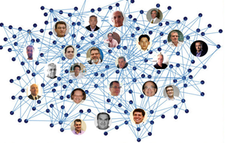
Strategies
WIDE DISSEMINATION, ESPECIALLY IN THE ELECTRONIC PORTALS AND MEETINGS OF CONTINENTAL/REGIONAL ENTITIES (E.G. FEPASEP, FESESUR, COESS);
ACHIEVE AT LEAST 2,000 (2000) ASSOCIATES;
    R$ 1,182,000 (1 million, 182,000 reais)
REALIZATION OF AGREEMENTS FOR THE DISSEMINATION OF INTERNATIONAL PRIVATE SECURITY EVENTS;

Slide 23






World Security Federation - WSF
  SBS Quadra 02, Bloco E, Edifício Prime Business,
  sala 1601/1602 Brazilia, Brazil – DF
  Phone: +55 61 33275440
  E-mail: executivo@wsf.org.br
  Site: http://wsf.org.br/
Sponsors:

Slide 24
Thank you
www.fenavist.org.br

